Slide 1
Statistics in SQL Server
A guessing game for the Query Optimizer

Slide 2
Links for this Session/Workshop
Scripts and Slide Decks https://github.com/db-berater/all-about-statistics
ERP Demo Database (17.00 GB) https://db-berater.de/downloads/ERP_Demo_2012.bak
SQLQueryStress https://github.com/ErikEJ/SqlQueryStress
Windows Admin Center https://go.microsoft.com/fwlink/?linkid=2220149

Slide 3




Uwe Ricken db Berater GmbH
I am working with IT-systems since early 1990's and with the main focus on Microsoft SQL Server since version 6.0. I started with development of database applications in 1998 with a professional CRM-System based on Microsoft products (Microsoft Office and Microsoft SQL Server).
Since 2008 I'm focused exclusively on Microsoft SQL Server and working in 3rd level support teams for banks, insurances and global industries.
Since May 2013 I am a Microsoft Certified Master: SQL Server 2008 which was an amazing way into the depth of Microsoft SQL Server.
In July 2013 I have been awarded with the MVP Award for Microsoft SQL Server.
www: http://www.db-berater.de
email: uwe.ricken@db-berater.de
blog: http://www.sqlmaster.de
BlueSky: @sqlbambi

Slide 4
Agenda
Introduction to Statistics
Basics of Statistics
Understanding Statistics Objects
Working with Statistics
Query Optimization and Statistics
Advanced Statistics Management
Statistics and Partitioned Tables
Troubleshooting Statistics Issues
Best Practices for Statistics Management

Slide 5
Introduction to Statistics
Overview of Statistics
Importance and Benefits of Statistics

Slide 6
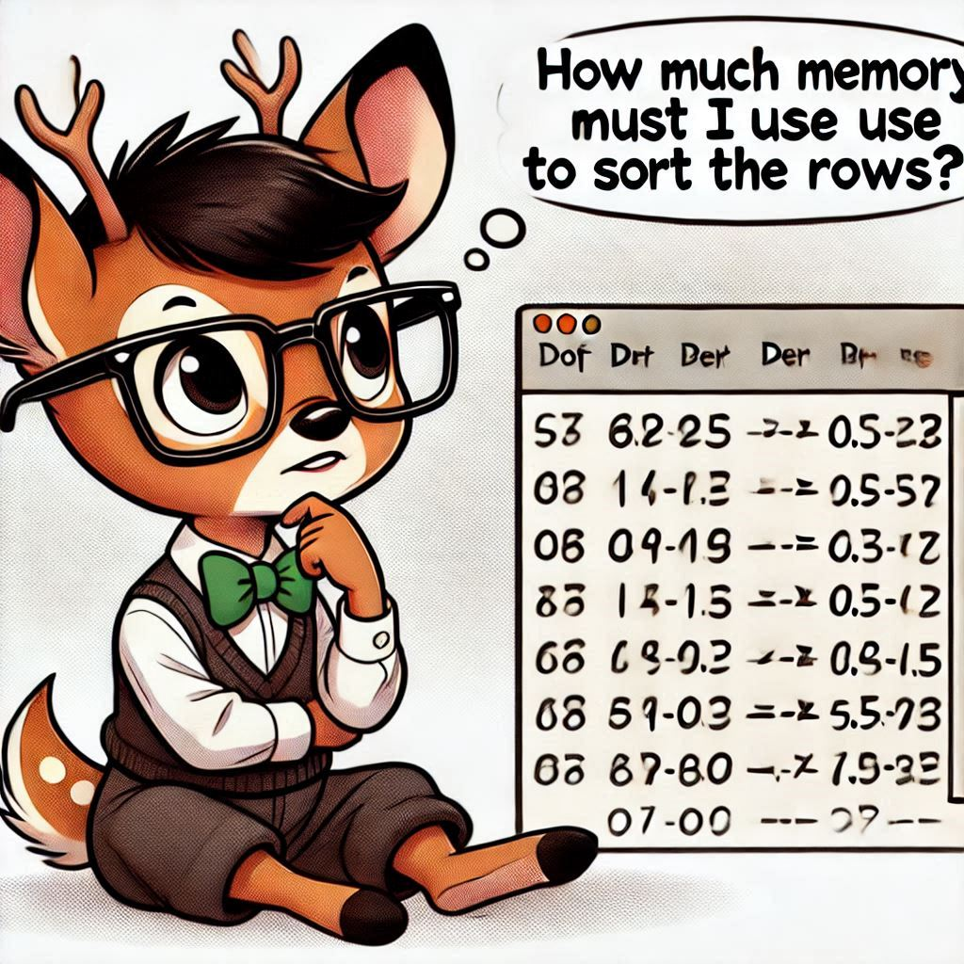
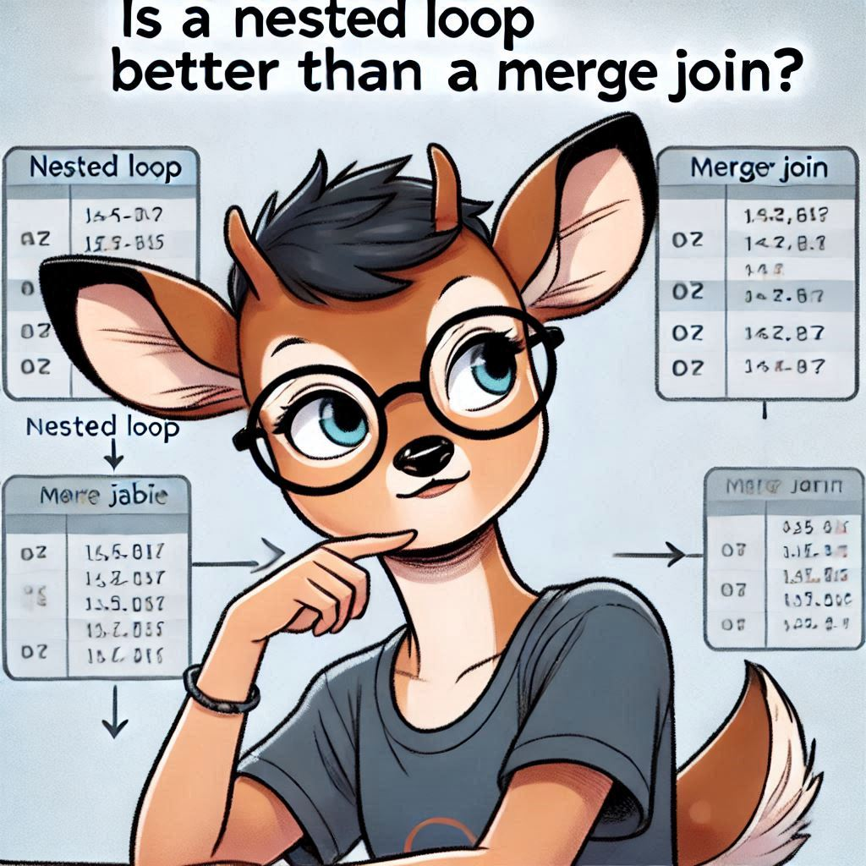
Overview of Statistics in SQL Server
What are Statistics
Statistics in SQL Server are data structures that store information about the distribution of values in a column
Statistics help the Query Optimizer to make efficient decisions about how to execute queries.
Importance and Benefits
Statistics in SQL Server are used by the Query Optimizer to make informed decisions about the query execution plan.
Accurate statistics improve query performance by providing the Query Optimizer with information about data distribution.

Slide 7
Database Settings
Creating and updating Statistics
Types of Statistics: Column/Index Statistics

Slide 8
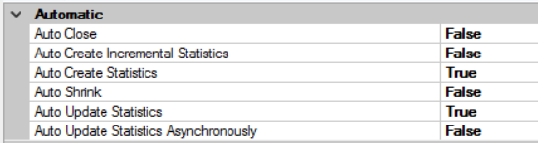
Database Settings
Automatically create statistics
Automatically update statistics
Automatically update statistics asynchronous
ALTER DATABASE ERP_Demo SET AUTO_CREATE_STATISTICS ON;
ALTER DATABASE ERP_Demo SET AUTO_UPDATE_STATISTICS ON;
ALTER DATABASE ERP_Demo SET AUTO_UPDATE_STATISTICS_ASYNC ON;

Slide 9
Basics of Statistics
Creating Statistics
Types of Statistics: Column/Index Statistics
Updating Statistics

Slide 10
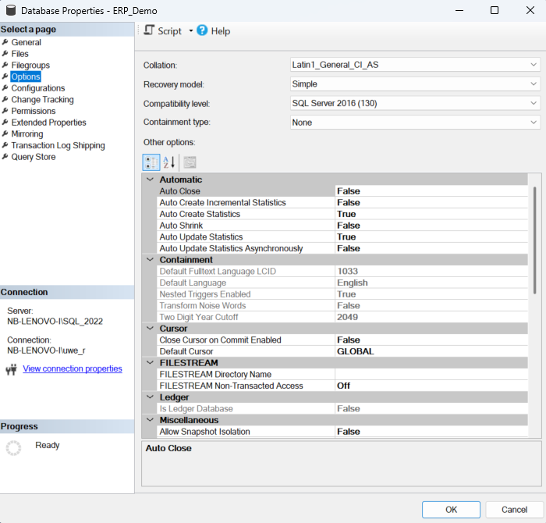
Basics of Statistics
Creating Statistics
statistics will be created automatically for indexes
SQL Server will create automatic statistics, when
no index are available and
DISTINCT
JOIN
WHERE
GROUP BY
ORDER BY
is used

Slide 11
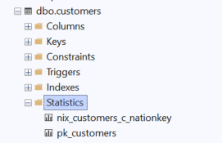
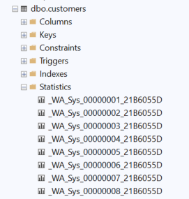
Basics of Statistics
Column Statistics
are created automatically if no index is available.
Are usually identified with the prefix _WA_Sys_
Index Statistics
are created automatically when the index is created/rebuilt
If an index statistics object exists no automatically created statistic will be created anymore.
The sample rate for statistics is ALWAYS 100% when the index is created/rebuilt!

Slide 12
Triggering Update of Statistics
SELECT *
FROM dbo.customers WHERE c_name = ‘db Berater GmbH’;
t₀
t₁
t₂
t_{n}
Compilation and Optimization
Binding Phase
Optimization Phase
No
Creating a Plan
Execute the Query
Loading Statistics
Out dated?
Yes
Update Statistics
SCH_S Lock
SCH_M Lock

Slide 13
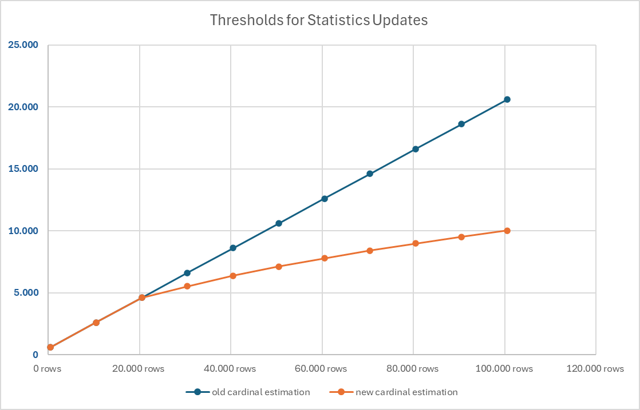
Basics of Statistics
Updating Statistics
If the cardinality of a table is between 7 and 500 the statistics will be updated after 500 modifications.
If the table has more than 500 rows the statistics will be updated after 500 + n modifications.
n depends on the version of the cardinal estimator!
<= 70: n = rows * 20%
>= 120: n = CASE WHEN rows <= 25000 THEN rows * 20% ELSE SQRT(1000 * rows) END

Slide 14
Automatic Update of Statistics
 | Old Cardinal Estimator SQL Server <= 2012 |  |  |  | New Cardinal Estimator SQL Server >= 2014
 | Trivial Plans |  | Full optimized Plans |  | Trivial Plans |  | Full Optimized Plans
 | AdHoc | Param. | AdHoc | Param. | AdHoc | Param. | AdHoc | Param.
< 500 rows | X | X | X | X | X | X | X | X
>=500 rows | X | X | ✓ | ✓ | X | X | ✓ | ✓

Slide 15
Understanding Statistics Objects
Creating Statistics
Types of Statistics: Column/Index Statistics
Updating Statistics

Slide 16
Organization of statistics
STATS_HEADER
common information about the statistics object
DENSITY_VECTOR
average distribution of records by unique attribute combination
HISTOGRAM
distribution of the first key/attribute of an index / statistics object

Slide 17

Usage of statistics objects
The histogram of a statistics object can only be used if the value of the predicate is known at compile time!
If the value of the predicate is not known, Microsoft SQL Server can only use the density vector! http://www.db-berater.de/2016/12/abfragen-nicht-mit-variablen-testen/

Slide 18
Background information about statistics
Statistiks in temporary Tables vs @TableVariables
update of statistics in empty tables
update of statistics in unique indexes
Filtered statistics

Slide 19
Temporary tables vs. Table variables
Temporary tables can use statistics
Table variables do not have the possibility to store statistics
The option RECOMPILE can be used when table variables are used http://www.db-berater.de/2015/06/temporaere-tabellen-vs-tabellenvariablen/

Slide 20
empty tables / unique indexes
When a table is empty no histogram data will be stored in the statistics
If the execution plan is „safe“ (the number of returned records is predictable!) no histogram data will be loaded again into memory and the existing execution plan from the cache is used!
If the execution plan is „unsafe“ (the number of returned records is NOT predictable!) the histogram data will be loaded again into the memory after an update of outdated statistics!

Slide 21
Maintenance of statistics
Statistics have to be updated regulary for efficient execution plans
Statistics will be recreated / updated by the following conditions:
Creation / Rebuild of an index
Execution of sp_updatestats
Execution of UPDATE STATISTICS
Automatic updated
Recommendation
http://ola.hallengren.com

Slide 22
Thank you!
Uwe Ricken
Partner:

